Slide 1


Combating COVID-19
Shenzhen Bus Group's Experience
Joe Ma
Deputy General Manager, SZBG
Chairman, Taxi & Ride-hailing Committee, UITP
Hallie Liao
Head of International Development
Shenzhen Bus Group

Slide 2
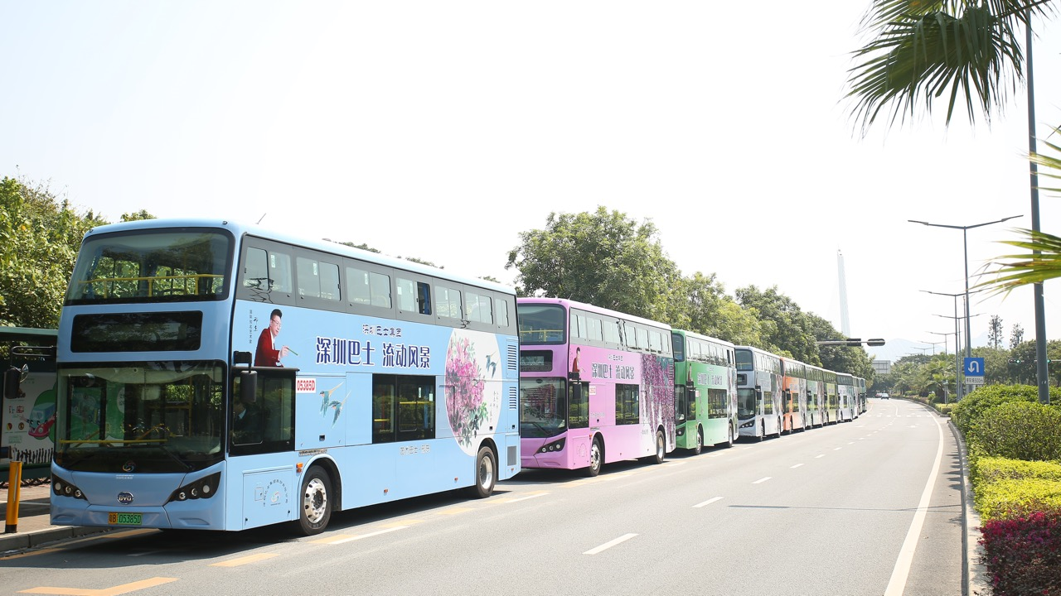
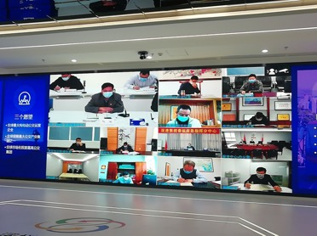

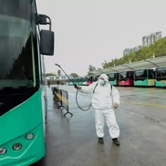

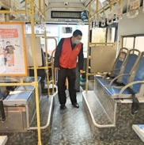
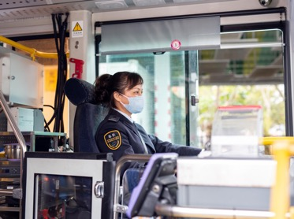
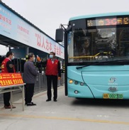
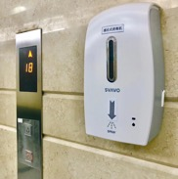
Emergency Measures
Notes:
There are many common challenges that Traditional public tranportation, especially bus face: For one: passengers lack information about road condition and ETA, a lot of scheduling is done manually, and the existing management systems are not intelligent enough.

Slide 3
Emergency Measures
Measures to adjust bus services during the epidemic
Emergency procurement procedures
Robust management of staff movement and deployment
Clear & unified information communication platform
Notes:
There are many common challenges that Traditional public tranportation, especially bus face: For one: passengers lack information about road condition and ETA, a lot of scheduling is done manually, and the existing management systems are not intelligent enough.

Slide 4
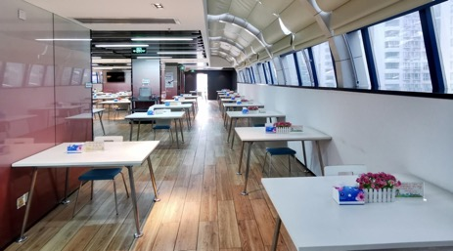
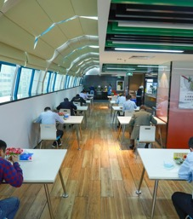
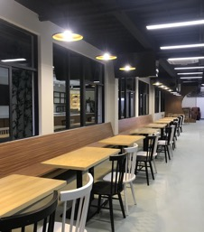
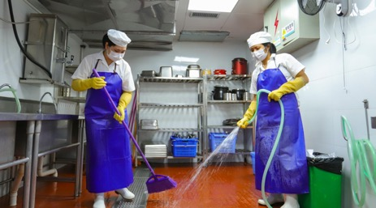
Emergency Measures
Canteen & Cafeteria Management
Notes:
There are many common challenges that Traditional public tranportation, especially bus face: For one: passengers lack information about road condition and ETA, a lot of scheduling is done manually, and the existing management systems are not intelligent enough.

Slide 5
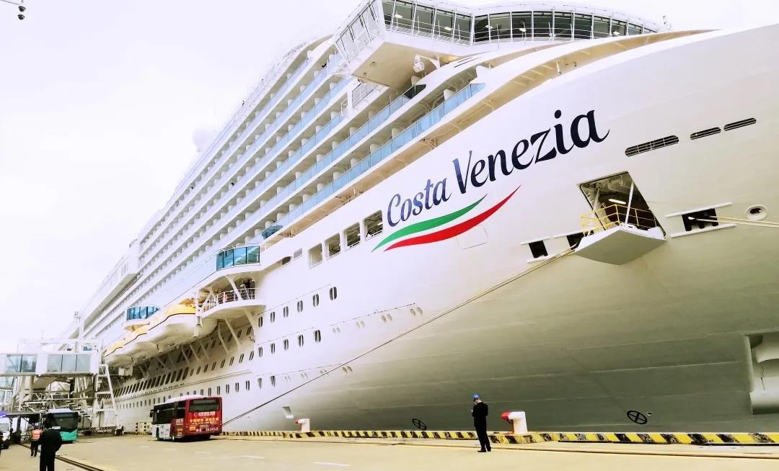
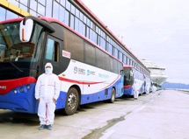
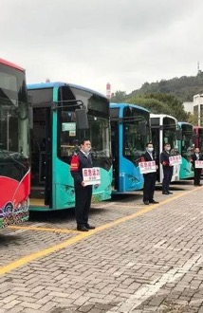
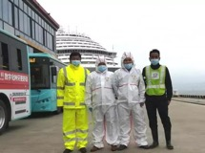
"Costa Venezia" Cruise Ship
Shekou Port
5,000 Passengers
148 Hubei Passengers
70 Emergency Vehicles
Seven Emergency Vehicles
Costa Venezia

Slide 6


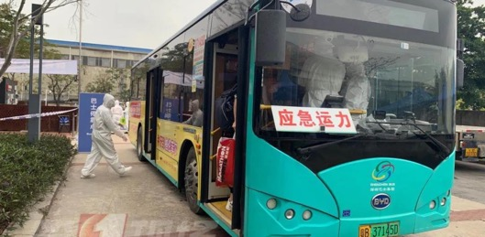
Shenzhen Bay Port
Important gateway
8 Disinfected Emergency Vehicles on Standby
202 Passengers were Transferred in 4 Days
Notes:
To dive in a bit deeper, our Udian on demand bus rolled out in 2016, Catering to commuters that have predictable destination and time requirement during peak hour. A typical line would have about 1-3 pick up points – no stop in the middle , 1-3 destinations (typically work places) to drop passengers off.

Slide 7
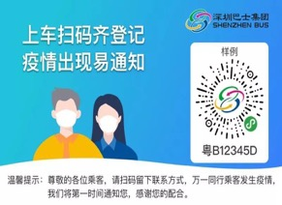
Resumption of Business & Work
1
14 Temperature Check Stations
2
“One Route One Plan”
“iShenzhen”
“Epidemic Prevention” APP
3
87 Lines for Key Areas
4
No more than 50% Passenger Loads
Notes:
To dive in a bit deeper, our Udian on demand bus rolled out in 2016, Catering to commuters that have predictable destination and time requirement during peak hour. A typical line would have about 1-3 pick up points – no stop in the middle , 1-3 destinations (typically work places) to drop passengers off.

Slide 8
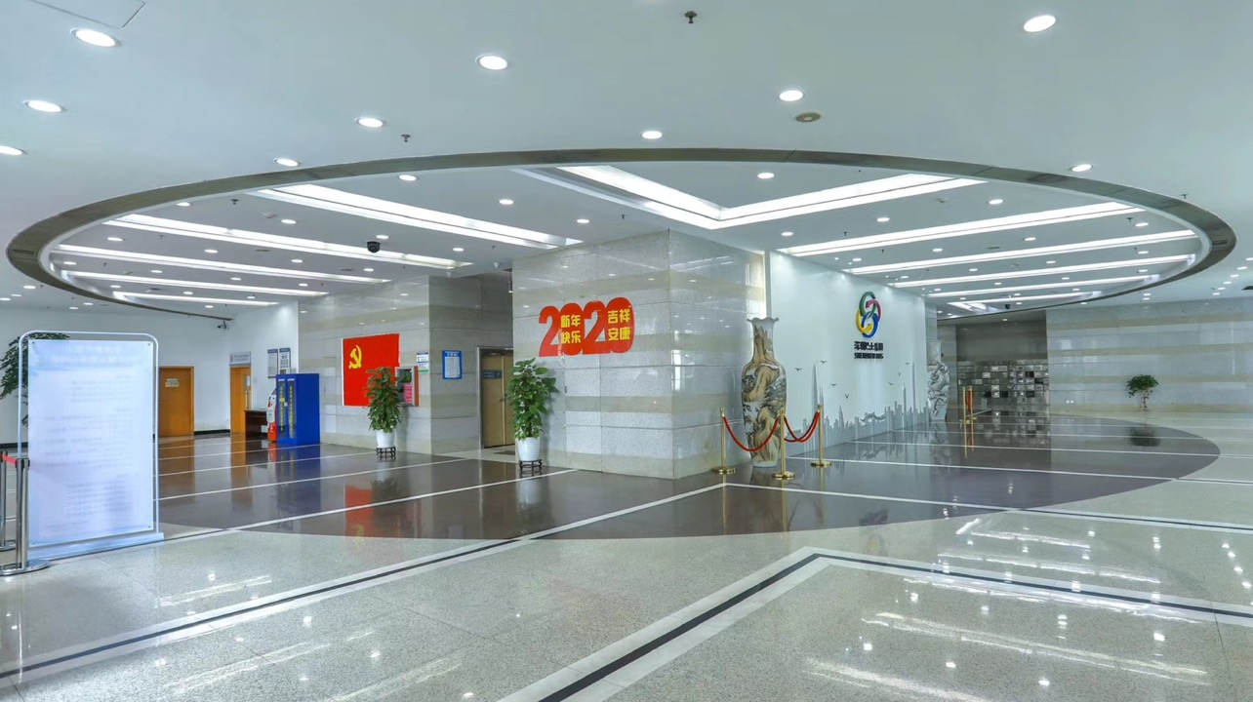
Online Training Courses
A Guide to Public Transport Epidemic Prevention
Technical Guide for Public Transport Disinfection
Training Evaluation Management System
Notification to Shenzhen Citizens, Incoming Visitors and Businesses
Mobilisation Measures Against Covid-19
Notes:
Notes:
1.Annual mileage is 70,000 km for per vehicle.
2.The price of electricity is 0.7 RMB/kwh and the unit price of charging service fee is 0.396 RMB/kwh.
3.The unit price for diesel is calculated according to the average purchase in 2016, which is 5.09 RMB (US$ 0.75)/litre.
4. Total 332 million RMB (US$ 48.9 million)/saving for all 6,053 no. of EVs.
5.KGCE: Kilogram of Coal Equivalent, TCE: Ton of Coal Equivalent.
6.Diesel coefficient is 1.4571 KGCE/kg, electricity coefficient is 0.1229 KGCE/kwh (1.4571 and 0.1229 being international standards for energy calculating equivalent)
7.Diesel density is 0.85kg/litre.
8.Total 157,900 TCE for all 6,053 no. of EVs.
9. ${CO}_{2}$ emission = fuel consumption x emission factor, and diesel emission factor is 3.1 of ${CO}_{2}$/ton.
10. Calculation does not take account of upstream ${CO}_{2}$ emission for power generation.
11. A total of 446,590 tons for ${CO}_{2}$ and 2,453 tons for other pollutant emission can be reduced for 6,053 no. of EVs.

Slide 9
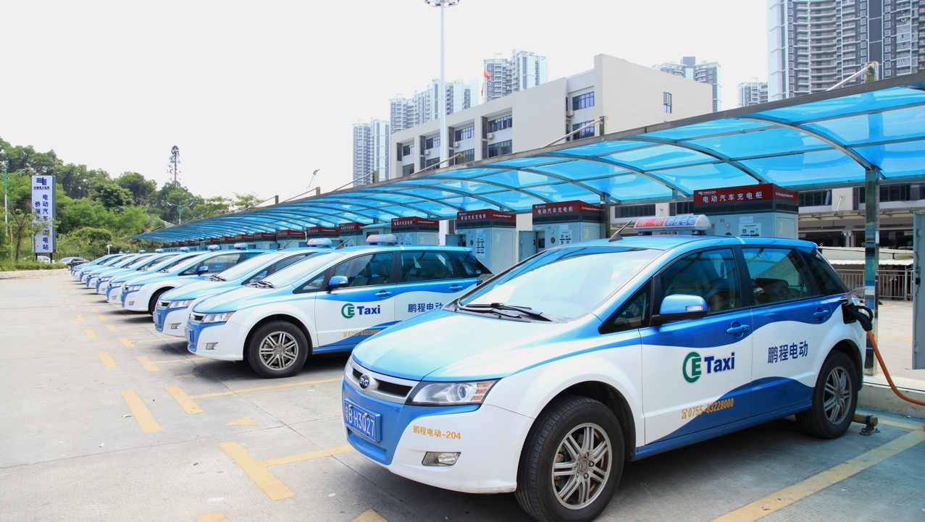

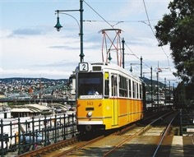
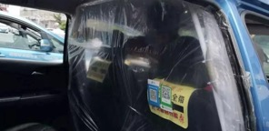
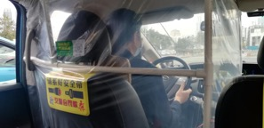
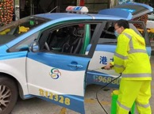
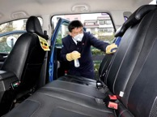
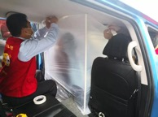
Taxi Services
Minimal Contact Anti-Virus Taxis
Disinfecting all vehicles at least 3 times everyday
Pengcheng Taxis & Shum Kong Taxis
All drivers are asked to register via a QR code
A 14-day mandatory quarantine
Stringent Measures at All Taxi Depots
Notes:
With the rapid development of the “Internet+”, the traditional taxi management model, which depends on taxi rental as the main income source, has become more difficult for operators and drivers alike, and it is also difficult to meet the diversified travel needs of passengers.
Taxi companies should break traditional ideas and develop related industries. SZBG has set up a new business by "build a pure electric taxi industry ecosystem where each vehicle is an independent economy."

Slide 10
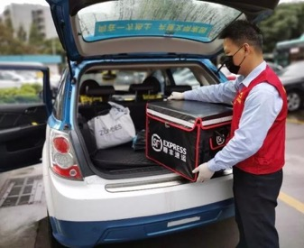
Taxi Services
Reducing monthly taxi rental fee & Cutting electricity charging service fee by half in 10 charging stations operated by SZBG.
750 Taxi Drivers & 4,000 Urgent Items
All Taxi drivers - Online Learning APP “Training Evaluation Management System”
Pengcheng Taxis & SF Express - Joint Courier Services.
Notes:
With the rapid development of the “Internet+”, the traditional taxi management model, which depends on taxi rental as the main income source, has become more difficult for operators and drivers alike, and it is also difficult to meet the diversified travel needs of passengers.
Taxi companies should break traditional ideas and develop related industries. SZBG has set up a new business by "build a pure electric taxi industry ecosystem where each vehicle is an independent economy."

Slide 11
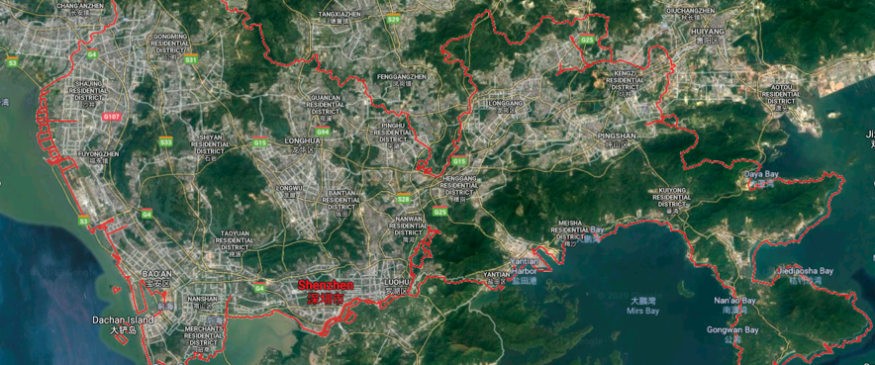
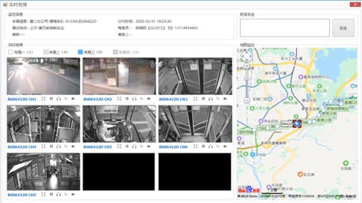
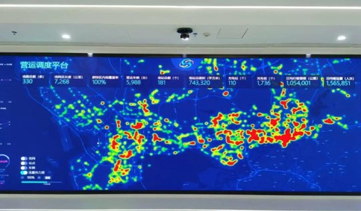
Intelligent Operation System
High-density Passenger Carriage Early Warning
Video Conference, Video Networking & Intelligent Dispatch
Notes:
With the rapid development of the “Internet+”, the traditional taxi management model, which depends on taxi rental as the main income source, has become more difficult for operators and drivers alike, and it is also difficult to meet the diversified travel needs of passengers.
Taxi companies should break traditional ideas and develop related industries. SZBG has set up a new business by "build a pure electric taxi industry ecosystem where each vehicle is an independent economy."

Slide 12
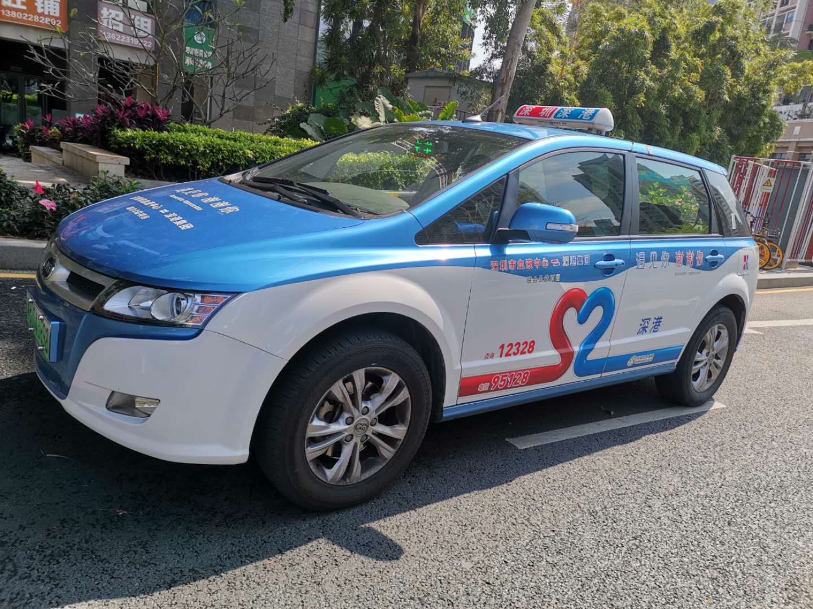
Caring for the Community & Staff
Free Transfer Service for Blood Donors
Free Health Service to Public Transport Staff through Online Clinics
Employee Assistance Programme (EAP)
Hotline for Counseling
Hairdressing Services
Notes:
Some numbers: we operate in 7 cities in china , with the largest operation in SZ. have more than 1650 lines, average occupancy rate is about 70%, much higher than our traditional buses of 40%, ththe registered users of user app is more than 500 thousand and more than 50 thousand users active per day.
平均里程数： 22km
时间： 比常规公交在途缩短30%

Slide 13
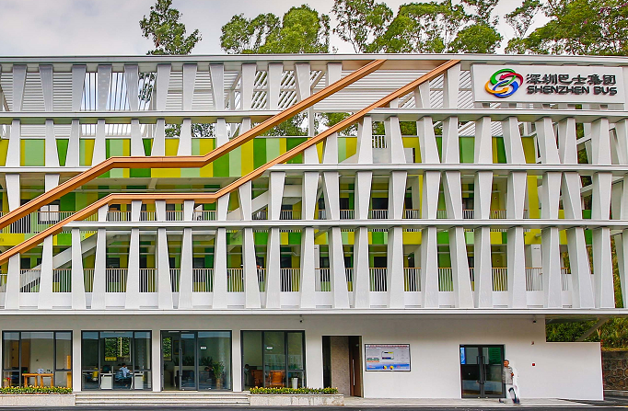
Thank You
International Development Department, Shenzhen Bus Group
info@szbus.org
en.szbus.com.cn

