Slide 1

Electric Mobility in CARICOM
Curtis Boodoo, Ph.d.
Assistant Professor
The University of Trinidad and Tobago curtis.boodoo@utt.edu.tt

Slide 2
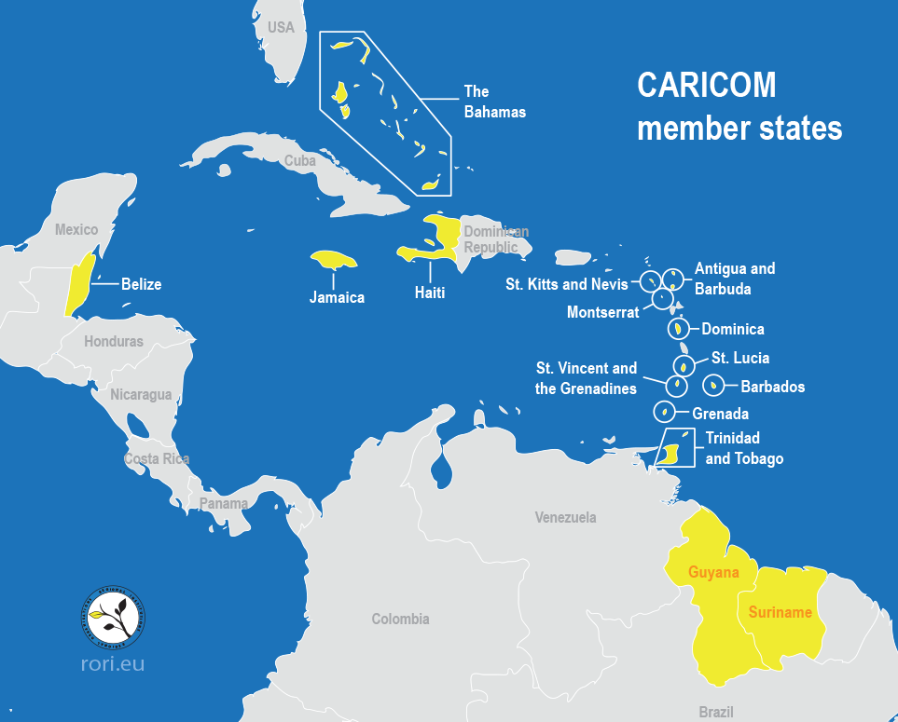


Notes:
CARICOM is the oldest surviving integration movement in the developing world. It is a grouping of twenty countries: fifteen Member States and five Associate Members.
CARICOM promotes and supports a unified Caribbean Community that is inclusive, resilient, competitive; sharing in economic, social and cultural prosperity.

Slide 3
CARICOM Countries | Population | Annual GDP | GDP per capita | HDI | Debt (M.$.) | Debt (%GDP) | Deficit (%GDP)
Antigua and Barbuda | 96,286 | 1,662M.$ | 17,261$ | 0.778 | 1,404 | 84.47% | -4.04%
Bahamas | 377,000 | 13,022M.$ | 34,584$ | 0.814 | 7,881 | 58.84% | -1.64%
Barbados | 287,000 | 5,209M.$ | 18,139$ | 0.814 | 6,347 | 134.09% | -3.17%
Belize | 408,000 | 1,837M.$ | 4,498$ | 0.716 | 1,930 | 105.08% | -3.97%
Dominica | 71,625 | 533M.$ | 7,442$ | 0.742 | 508 | 90.76% | -3.34%
Grenada | 111,454 | 1,218M.$ | 10,928$ | 0.779 | 719 | 59.08% | 4.95%
Guyana | 785,000 | 5,174M.$ | 6,594$ | 0.682 | 2,059 | 39.79% | -2.59%
Haiti | 11,123,176 | 9,658M.$ | 868$ | 0.510 | 4,151 | 47.69% | -2.28%
Jamaica | 2,726,000 | 15,884M.$ | 5,826$ | 0.734 | 14,612 | 101.33% | -3.04%
Saint Kitts and Nevis | 52,441 | 1,066M.$ | 20,328$ | 0.779 | 599 | 56.22% | -1.02%
Saint Lucia | 181,889 | 2,066M.$ | 11,359$ | 0.759 | 1,247 | 59.98% | -1.03%
Saint Vincent and the Grenadines | 110,210 | 824M.$ | 7,477$ | 0.738 | 620 | 75.20% | -2.38%
Suriname | 575,991 | 3,465M.$ | 6,016$ | 0.738 | 2,617 | 75.56% | -7.47%
Trinidad and Tobago | 1,390,000 | 23,808M.$ | 17,130$ | 0.796 | 10,846 | 45.12% | -3.69%
TOTAL: CARICOM | 18,296,072 | 85,426M.$ | 4,669$ |  | 55,539 | 67.14%
Source: https://countryeconomy.com/countries/groups/caribbean-community
Notes:
Human Development Index most countries between High human development and Medium human development. Haiti Low human development index.

Slide 4
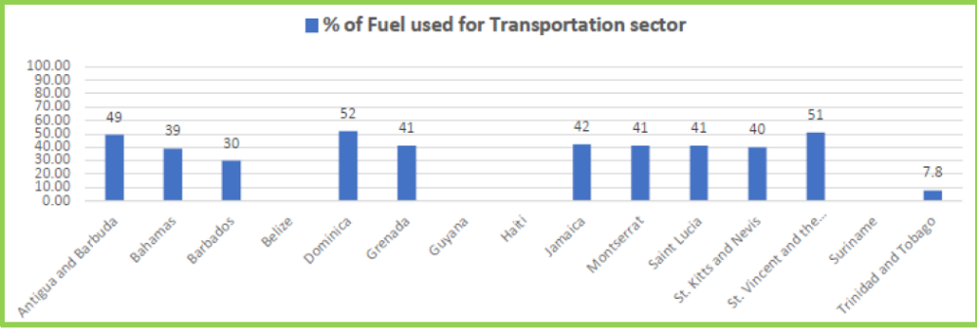
Opportunities - Liquid Transportation Fuel Usage
Source: The Future of E-Mobility in the Caribbean, CCREEE Feb 2020
Notes:
Most of the small islands over 40% of the imported fuel is used for transportation. Trinidad and Tobago now imports its transportation fuel. Imported fuel for electricity generation is being addressed by investment in RE. What is needed is to also reduce imported fuel used for transportation. A solution to this is investing in EVs. Well to wheel analysis Evs are 3 times more efficient than ICE vehicles and make use of indigenous RE sources.

Slide 5
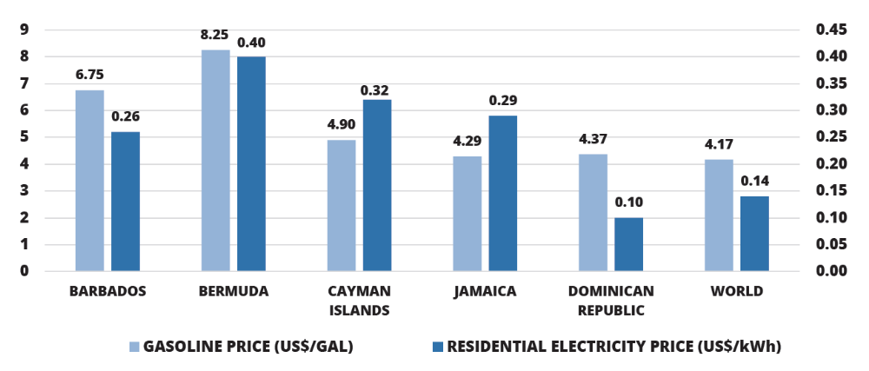
Opportunities - Electricity vs Gasoline Cost
Source: Electrified Islands, OAS and IDB, Feb 2020

Slide 6
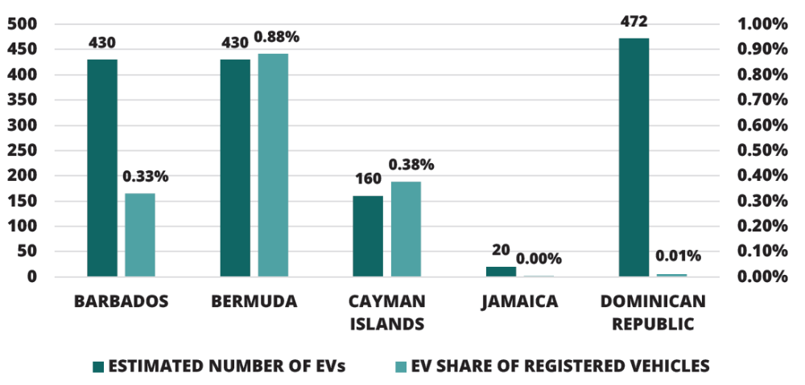
EV Deployment in the region
Source: Electrified Islands, OAS and IDB Feb 2020
Notes:
EV deployment very small. It must be increased. Policy co-ordination at a regional level is required.

Slide 7


Clean Transportation Policies in CARICOM

Slide 8
CARICOM Energy Policy 2013 – Energy use for Transportation
Implement strategies to encourage fuel switching in the transportation sector and improve fuel conservation and efficiency in ground, marine and aviation transportation.
Promote the use of fuel efficient vehicles.
Promote the use of cleaner fuels.
Identify appropriate incentives for promoting technological development in fuel switching as well as the use of electric and hybrid vehicles and collaborate with electric utilities on suitable high-voltage upgrades to national grids.
Apply appropriate planning designs to the road transportation networks and in traffic management to promote energy efficiency.
Identify and implement alternative modes of transport, in particular mass transit systems.
Notes:
This CARICOM Energy Policy was approved by the Forty-First Special Meeting of the Council for Trade and Economic Development
(COTED) on ENERGY held 1 March 2013, in Trinidad and Tobago

Slide 9
C-SERMS 2015 : Transportation sector
Transportation’s sector overlooked because of the sector’s complexity and lack of available data.
The promotion of HEV and EV capable of reducing fuel consumption by 47% and 73%, respectively, could greatly benefit the CARICOM region.
Electric vehicles also can provide ancillary benefits when integrated with renewable energy and smart grid development.

Slide 10
NDC Commitments for CARICOM Nations
CARICOM Country | NDC commitment related to Transportation | NDC commitment related to Energy
Antigua and Barbuda | By 2020, establish efficiency standards for the importation of all vehicles. | By 2030, achieve an energy matrix with 50 MW of electricity from renewable sources both on and off-grid in the public and private sectors.
Bahamas |  | 30% RE in energy mix by 2030 allow 10% Residential Energy Self Generation within the year.
Barbados | a 29% reduction in non-electric energy consumption including transport, compared to a BAU scenario in 2029 | Renewable energy: contributing 65% of total peak electrical demand by 2030. Electrical energy efficiency: a 22% reduction in electricity consumption compared to a BAU10 scenario in 2029.
Belize | 20% reduction in Conventional transportation fuel use by 2030 | Reduction in energy intensity per capita at least by 30% by 2033. Reduce fuels imports dependency by 50% by 2020 using renewable energy. 85% renewable energy by 2030
Dominica | By 2030, total emission reductions in Transport – 16.9%; | By 2030, total emission reductions in Energy industries – 98.6%
Grenada | Reduce its emissions in the transport sector by 20% by 2025 | A 30% reduction in emissions through electricity production by 2025 with 10% from renewables and 20% from energy efficiency measures.
Notes:
The energy sector is defined in accordance with ( Inter-government Panel on Climate Change )IPCC guidelines, and includes the transportation sector.

Slide 11
NDC Commitments for CARICOM Nations – cont’d
Guyana |  | 100% renewable power supply by 2025.
Haiti | Control, regulate the import of used vehicles. | Increase to 47% the share of renewable energies in the system Haitian electricity by 2030 (hydro 24.5%, wind 9.4%, solar 7.5%, biomass 5.6%)
Jamaica |  | Renewable Energy increase to 20% by 2030. Prime Minister announced 50% by 2030.
Saint Lucia | Efficient Vehicles ,Improved and Expanded Public Transit. Introduced a new levy to control importation of used vehicles Reduction of excise tax and duty for importers of fuel efficient vehicles and alternative energy vehicles | 35% Renewable Energy Target by 2025 and 50% by 2030
St Kitts and Nevis | At Least reduce 5% of the national fuel consumption. | Increase the use of renewable energy sources by 50%
St Vincent and the Grenadines | New policies to reduce the import duty paid on low emission vehicles | Generate approximately 50% of the national annual electricity consumption needs From Geothermal Energy. Energy Efficency:15% reduction in national electricity consumption compared to a BAU scenario by 2025
Suriname |  | 31% emission reduction by 2025
Trinidad and Tobago | 30% reduction in GHG emissions by 2030 in the public transportation sector

Slide 12
The Need for a Regional Policy
Transportation Policies are not as developed as Energy Polices in the Region. (Nationally and Regionally)
Transportation planning is complex and involves Energy, Tourism, Urban planning and Social programs.
Regional focus on reducing energy imports and reducing emissions.
Prepare the region through policy and planning for emerging transportation technologies and models.
Notes:
C-SERMS approved in 2015.
Now is the time to foster the natural synergy that can exist between the electrification of transportation and sustainable energy.

Slide 13
Electric Vehicle Work Group (EVWG)
CARICOM EVWG established in Nov 2017.
Members: Financial Institutions, Regional EV dealerships, Utility Companies, Energy and Transport Ministries and Regional Developmental Partners.
Aims
To provide a forum through which national governments, institutions and industry players share experiences, lessons learned and good practices on electric vehicle use and performance within the region.
Information and analytics that emerge from the group will serve as a guide towards the development of electric vehicle policies and strategies within CARICOM, aiming at a regional roadmap on e-mobility.
Guide and inform the implementation of national and regional energy and transport action plans.

Slide 14
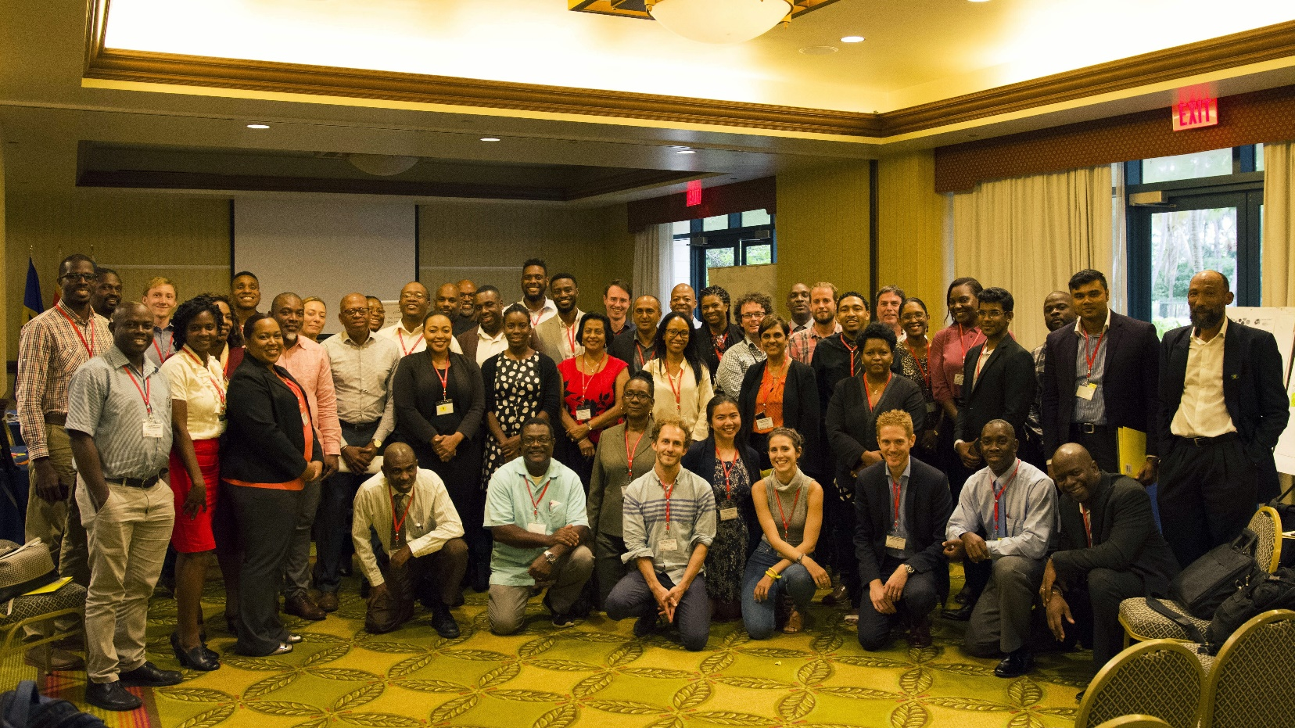
Electric Mobility Workshop (ELMo lab and Technology Expo – June 2018 Barbados.
EVWG, CARICOM Energy and GIZ.
Notes:
The triple helix model of innovation refers to a set of interactions between academia, industry and governments, to foster economic and social development

Slide 15
ELMo lab and Technology Expo - cont’d
Participants engaged in a co-creative innovation process called Design Thinking focused on creating a Regional Roadmap for Electric Mobility.
Solutions to E-mobility Challenges in the region:
Innovative financing options.
Training, Associations, Peer to Peer knowledge sharing.
EV ,Resilience and Grid Modernization.
Incentives for EVs.

Slide 16



Regional Electric Vehicle Strategy (REVS)
CARICOM Energy
Chaos Theory
REVS
EVWG
CCREEE
EVWG

Slide 17
REVS
Aim
To deliver intelligent, modern, affordable, clean, efficient and safe mobility solutions for CARICOM citizens and businesses through the electrification of surface transportation within the Community
Strategic
Imperatives
Innovation
Intelligence
Electrification
Implementation
Initiatives
Finance, market Development and Business Innovation
Capacity Development and Awareness
Technology and Infrastructure
Notes:
Caribbean Electric Utility Services Corporation (CARILEC), utility companies around the Caribbean need to embrace a new business model built on digitisation, decarbonisation and decentralisation (the 3Ds).
With the advent of EVs and the electrification of transportation the 3Ds are relevant in transportation. The goal is to harness these disruptors by focusing on the three strategic imperatives.
Innovative business models – including policy makers, utility companies, consumers and the private sector; particularly gas stations, commercial centres, telecommunication providers, insurance companies, car dealers and technicians (electricians and auto-mechanics) – will be essential to meet the demands of a transition to electric mobility
Intelligence in electric mobility encompasses intelligence in vehicle operations, electrical power infrastructure, and grid integration. A connected network of cars and drivers, infrastructure and communities are important elements of sustainable electrified transport systems, which will require a transition to smart networks.
The integration of mobility into the electricity sector through the deployment of digital technologies requires flexibility options for grid management, appropriate storage capacities and options. These options should be based on a renewable and efficient energy supply, to the benefit of Caribbean countries.
A series of initiatives will facilitate the achievement of the overall aim of the REVS, taking the three strategic imperatives into account and creating a dynamic enabling framework for electric mobility in the areas of
Throughout these initiatives, a market-specific approach that considers all relevant stakeholders will be applied. High-use vehicles in public and commercial fleets will be prioritised, and technology and infrastructure will be deployed with a view to meet current and future transportation requirements.

Slide 18

Capacity Development and Awareness

Slide 19
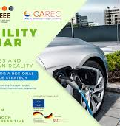
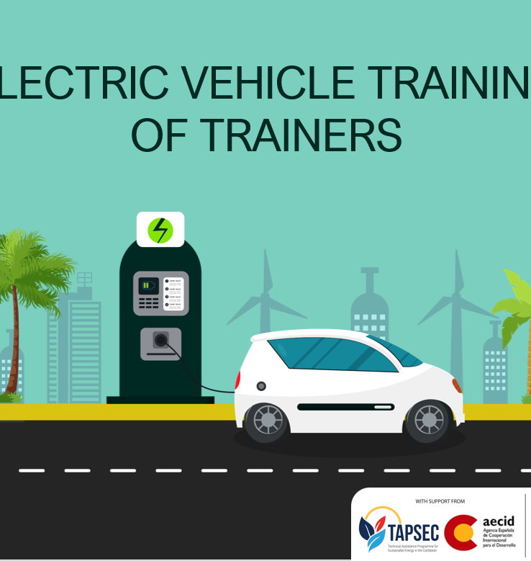
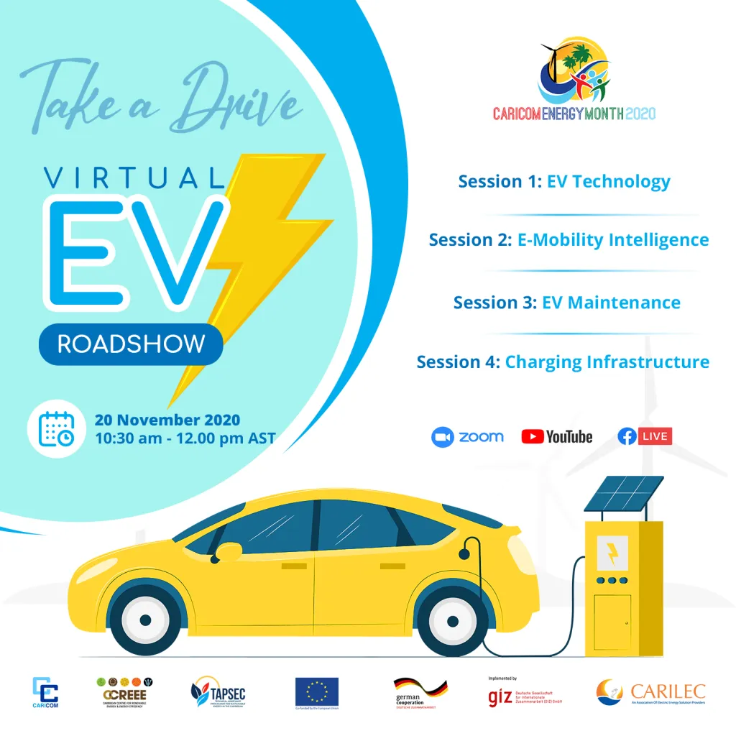
2020
E-Mobility Webinar: Innovation, Opportunities and the Caribbean Reality – Considerations for a Regional Electric Vehicle Strategy June 16th 2020
Come Take a Drive’ Virtual Electric Vehicle Roadshow Nov 20th 2020
Electric Vehicle Maintenance Training of Trainers Programme (online training)
November 18th 2020 (commencing with module one)
The CARICOM Energy Knowledge Hub
Notes:
The programme has specifically targeted: Instructors representing training institutions within CARICOM and its member states Automotive mechanics trainers First responder trainers Regulators, electrical inspectors and customs personnel.
Module one provided more than 160 registered participants with the opportunity to learn more about basic and advanced electric vehicle technology; servicing and maintenance; electric vehicle/hybrid electric vehicle safety; and standards, testing and regulation.
With interest registered from more than 300 persons across CARICOM’s fifteen Member States, the CCREEE intends to further support electric mobility capacity development by offering the training programme again in the near future.
The Knowledge Hub encompasses a Community of Practice of sustainable energy practitioners (governments, utilities, regulators, private sector clean energy developers, universities, international development partners, civil society)

Slide 20
Innovative Ecosystems

Slide 21
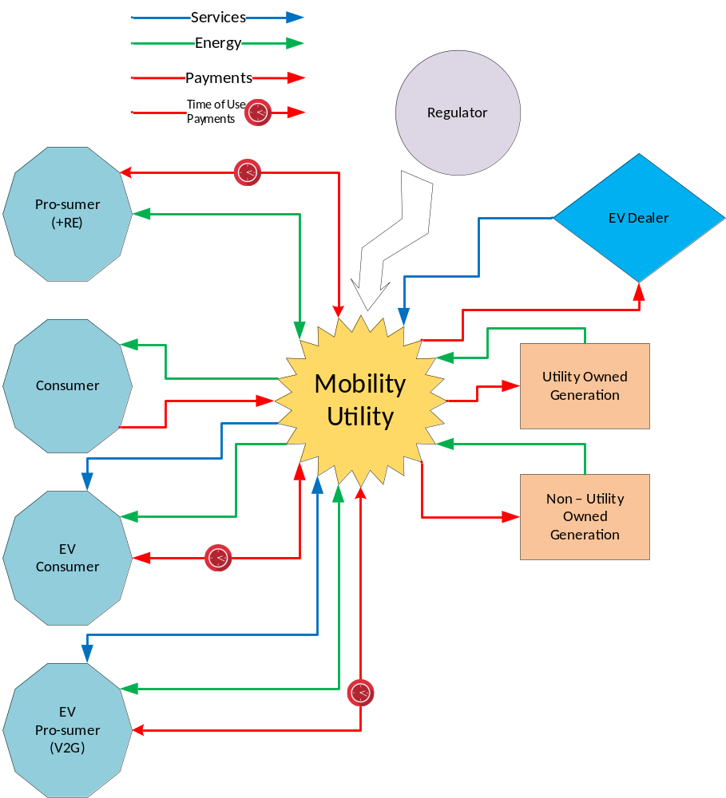
Innovative Models –
The Mobility Utility
Source: Hall, Stephen, Shepherd, Simon and Wadud, Zia.The Innovation Interface Business Model innovation for Electric Vehicle futures. : University of Leeds, 2017.

Slide 22
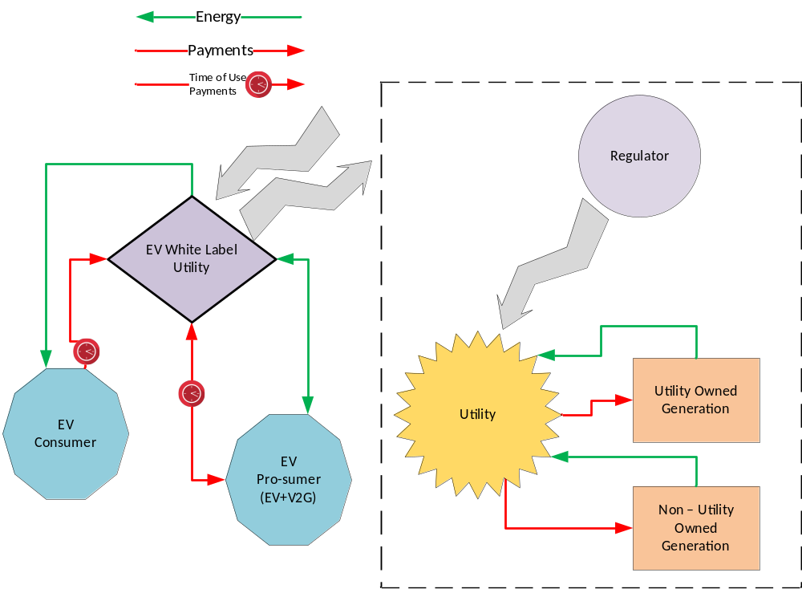
Innovative Models –
The EV White Label

Slide 23

Case Study - Barbados
Notes:
Public transportation came later.
Private sector driven.

Slide 24
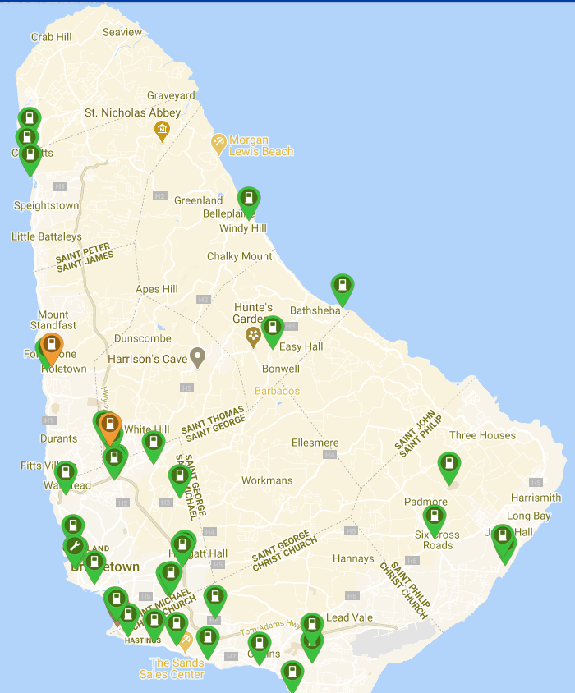
GENERAL FACTS
166 square miles (430 km squared)
Approx. 131,680 privately registered vehicles
1.2 vehicles for every employed person
31% of annual fuel consumption
3500 barrels of oil per day
$165,000 USD/day
≈ 500 Electric Vehicles currently in Barbados
EV Charging Network Summary ≈ 119 Total EV Chargers
Notes:
287000/ 500 = 1 : 574 people own and EV

Slide 25
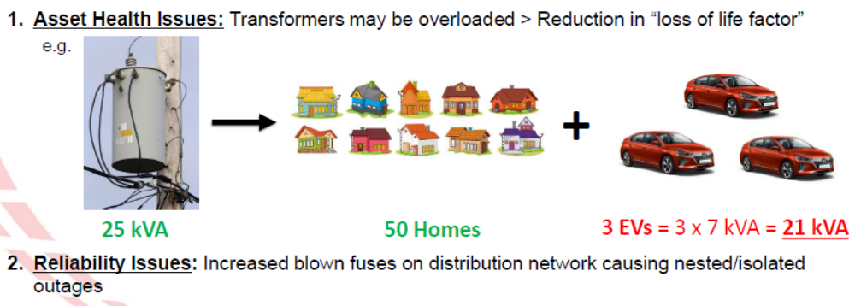
Challenge Electric Vehicles can Overload Equipment on Distribution Network
Source: How Prepared Are The Utilities To Respond To Grid Impacts Associated With Electric Mobility Transitions – Antonio Sealy
Notes:
Around 262 MW of installed capacity.

Slide 26
Solutions to Mitigate Impact on the Grid related to Electric Vehicle Uptake
1. Education – Customers and key stakeholders
2. Grid Monitoring & Analytics
– Advanced Metering Infrastructure
3. Surveys and Data Collection
– Determine who are your EV owners
4. Smart Charging
– Demand Response
– Staggered Charging
– Curtailment
5. Proper Resource Planning & Forecasting
– Understand how EV population will grow and what is required
6. Rates
– Time of Use Rates
– Sub metering programs
7. Direct Load Control & Vehicle to Grid (V2G)
– Advanced level
Source: How Prepared Are The Utilities To Respond To Grid Impacts Associated With Electric Mobility Transitions – Antonio Sealy

Slide 27
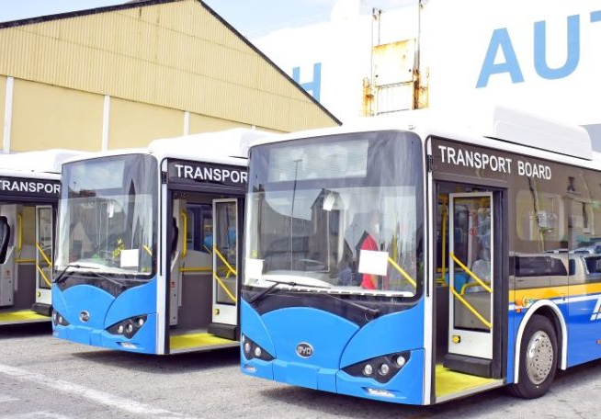
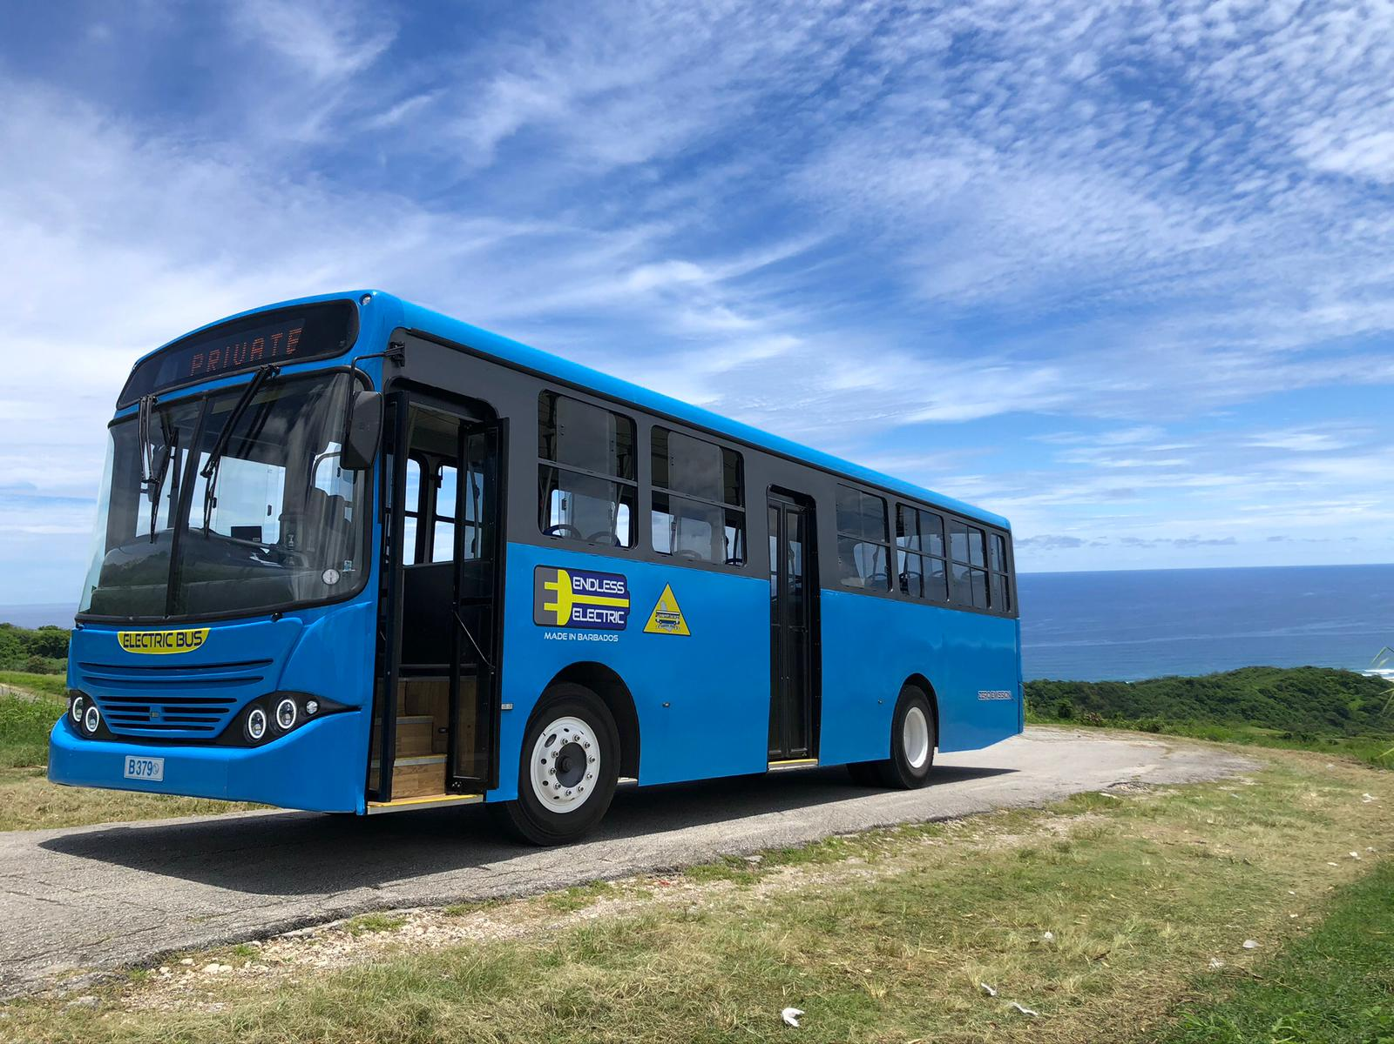
Public Transportation

Slide 28

Ingredients for Success– Barbados
Highest liquid transportation fuel prices in the region.
Innovative private company that embraced the natural synergy between EVs and RE.
Progressive Power Utility Company
Early investment in a charging infrastructure.
Early adoption by fleet owners.
Electrification of public transportation.
Zero rated taxes and duties on EVs
Notes:
Public transportation came later.
Private sector driven.

Slide 29
Emerging Technologies

Slide 30
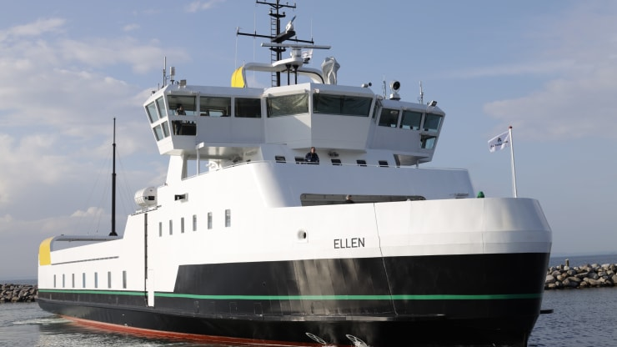
Indigenous Maritime Transportation
Twin Island State | Approximate Distance (km)
Antigua and Barbuda | 55
Saint Kitts and Nevis | 5.5
Trinidad and Tobago | 158
Saint Vincent to Bequia | 18
Launched 2019
Danish islands
4.3 megawatt hours (Leclanche)
High charging power capacity of 4.4 MW
Range 40 km
€21 million cost to build
25 orders

Slide 31
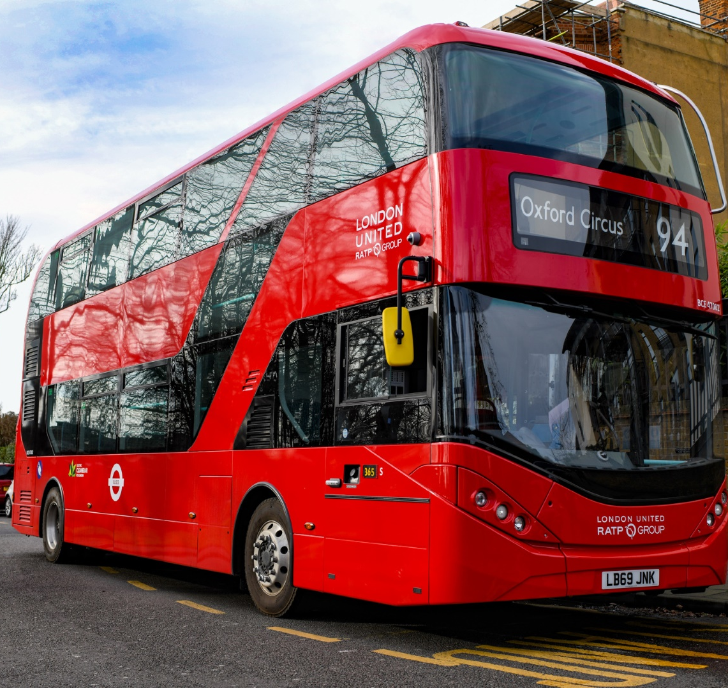
V2G - Bus2Grid project
Launched August 2020
28 of the state-of-the-art double decker buses
BYD ADL Enviro400EV, double decker
382kWh BYD lithium iron phosphate batteries
40kW chargers

Slide 32
Regional Transportation Hurdles and Bridges

Slide 33
Bridges and Hurdles
Absence of any automotive manufacturer in the region.
Small markets have deterred vendors and their products and services incur higher cost. (pilot projects)
Inefficient and unsafe Public Transportation.
Upgrade and re-design of road networks.
Lack of infrastructure that encourages non-motorized forms of transportation ( walking, biking, e-bikes etc)
Absence of modern technology use in Public Transportation and Traffic Management.
Un-coordinated and unregulated importation of used vehicles.
Absence or inadequately enforced policies for the disposal of automotive waste and end of life vehicles.
Technical component labour force with experience in engineering and manufacturing.
Network of certified and uncertified auto-technicians.
Abundant Renewable Energy Resource.
A National and Regional focus on ICT.
Mature and successful regional co-ordinating entity – CARICOM.
A focus on Small and Medium-Sized enterprises (SMEs)
A focus on eco-tourism
Notes:
SMEs play a crucial role in the economic development of Caribbean economies. Collectively, they generate about 40 per cent of the Caribbean subregion’s Gross Domestic Product (GDP).

Slide 34
Sustainable Transportation
Social
Economic
Environmental
Sustainable
Transportation
Energy
Transportation
Tourism / Agriculture
Notes:
Sustainability and change theme in tourism master plan. National Conservation: Develop strategies to foster and encourage sustainable
environmental, ecological and institutional practices

Slide 35

Thank you for Listening
curtis.boodoo@utt.edu.tt

